Slide 1
PREDICT THE LOAN ELIGIBILITY FOR DREAM HOUSING FINANCE COMPANY
EC 9560: DATA MINING
MINI PROJECT
GROUP MEMBERS – 2019/E/166 2019/E/156

Slide 2
CONTENT
01
INTRODUCTION AND OBJECTIVES
Slide 03 - 04
02
ABOUT THE DATASET
Slide 05 - 06
03
NATURE OF THE PROBLEM
Slide 07 - 08
04
Progress up-to now
Slide 09 - 16
05
Thank you
Slide 17
02

Slide 3
INTRODUCTION
Dream Housing Finance company deals in home loans.
Customers first apply for a home loan after that company validates the customer’s eligibility for a loan.
The company wants to automate the loan eligibility process (real-time) based on customer detail provided while filling out the online application form.
03

Slide 4
OBJECTIVE
Understand the dataset, features and preprocessing.
Build the model and increase the accuracy of the model.
04

Slide 5
ABOUT THE DATASET
DATASET CONTAINS 2 FILES
1.Train Data Set - contains the customers for whom loan eligibility is known as 'Loan_Status’. (614 Rows)
2.Test Data Set - contains the customer information for whom loan eligibility is to be predicted. (367 Rows)
05

Slide 6
Train dataset contains 13 attributes.
VARIABLE | DESCRIPTION
Loan_ID | Unique Loan ID
Gender | Male/ Female
Married | Applicant married (Y/N)
Dependents | Number of dependents
Education | Applicant Education (Graduate/ Under Graduate)
Self_Employed | Self employed (Y/N)
ApplicantIncome | Applicant income
CoapplicantIncome | Coapplicant income
LoanAmount | Loan amount in thousands
Loan_Amount_Term | Term of loan in months
Credit_History | credit history meets guidelines
Property_Area | Urban/ Semi Urban/ Rural
Loan_Status | (Target) Loan approved (Y/N)
06

Slide 7

NATURE OF THE PROBLEM
This loan prediction problem is a classification problem.
Because the goal is to predict whether a person’s loan will be approved or not. In addition to this, this is a binary classification problem too, as there are only two possible outcomes called ‘Y’ or ‘N’. In here Y stands for loan is approved as well as N stands for not approved or rejected.
07

Slide 8
Libraries
Pandas
Sklearn
Numpy
Matplotlib
08

Slide 9
Progress upto now (Cont.)
Data exploration & preprocessing:
Data Visualization
Dropping the duplicates
Handling Missing Values
Handling Outliers
Handling Class Imbalance
Feature Engineering
Checking for correlation
Converting Categorical to Numerical
Feature Scaling
Feature Selection
Model selection, training, evaluation and Hyperparameter Tuning
09

Slide 10
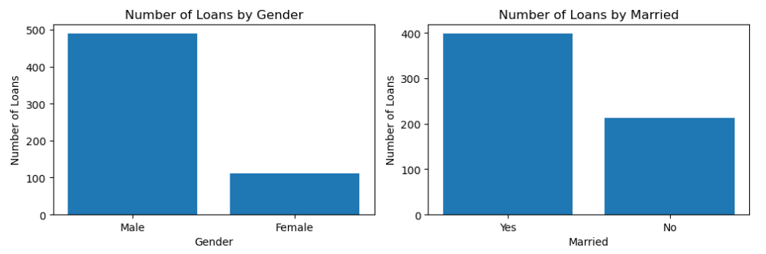
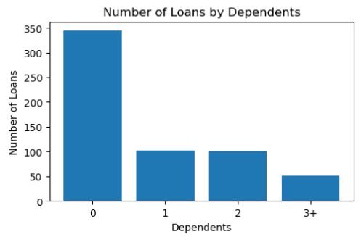
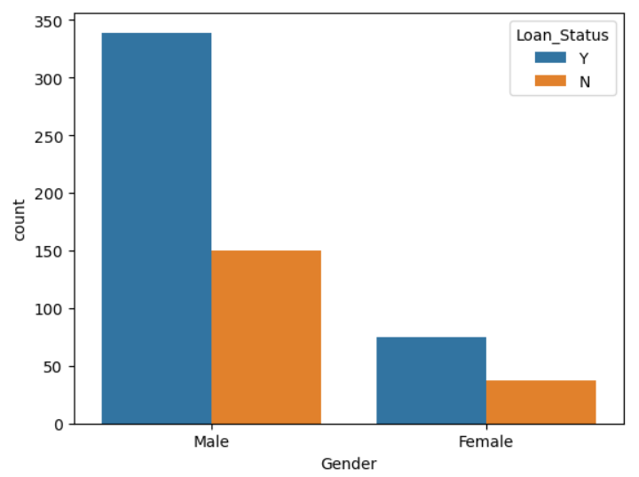
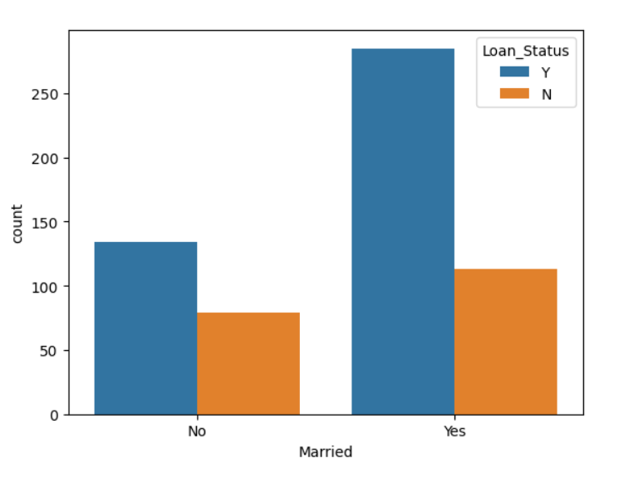
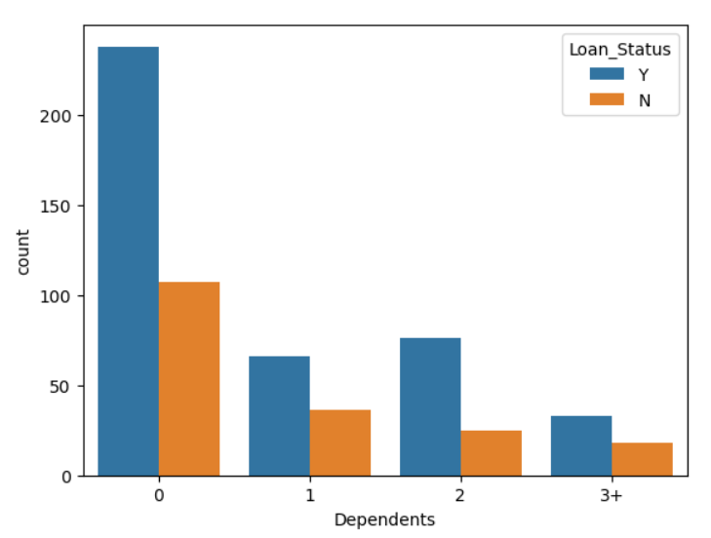
Graphical representation about the instances in each categorical features.
10

Slide 11
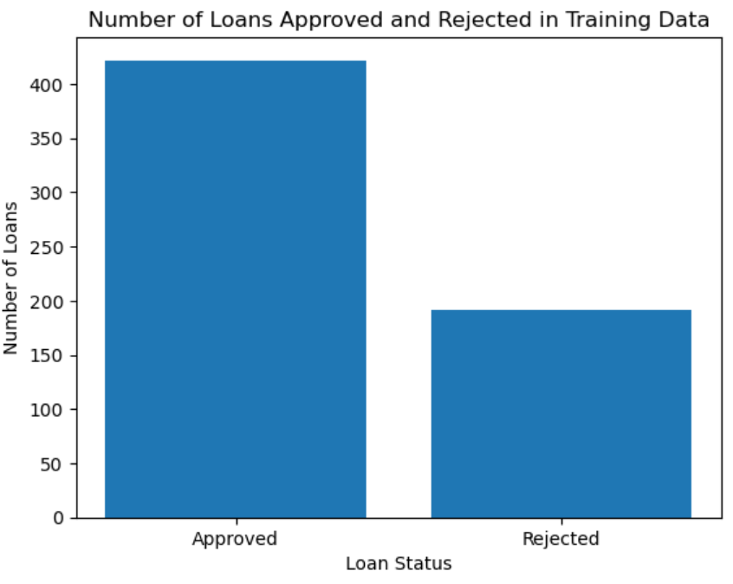
Graphical Representation about the instances in target class.
Loan_Approved (Y) – 422
Loan_Rejected (N) – 192
11

Slide 12
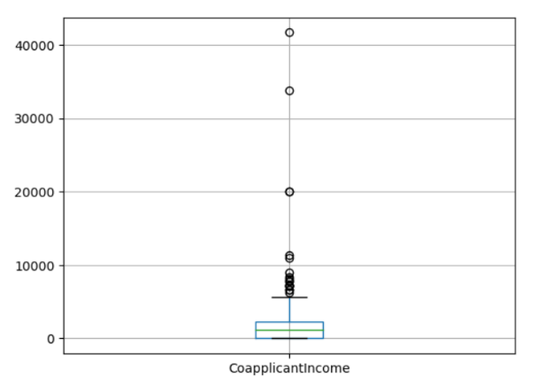
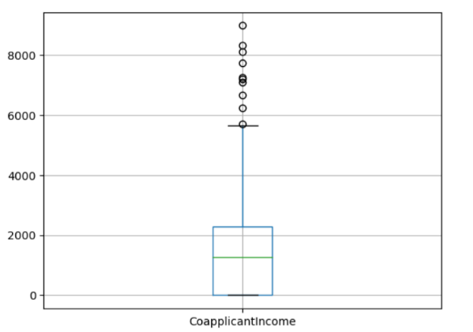
Dropping the Duplicates
There were no duplicates.
Handling outliers
12

Slide 13
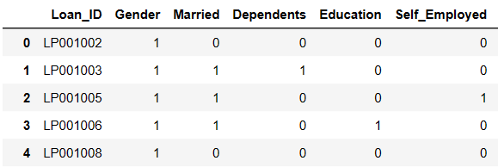
Handling Missing values
Dropped some values, use mode, median to replace
Converting categorical values to numerical values
13

Slide 14
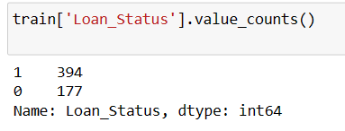
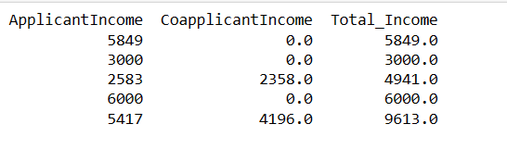
Handling class imbalance
Feature engineering
Created a new feature as Total income
14

Slide 15
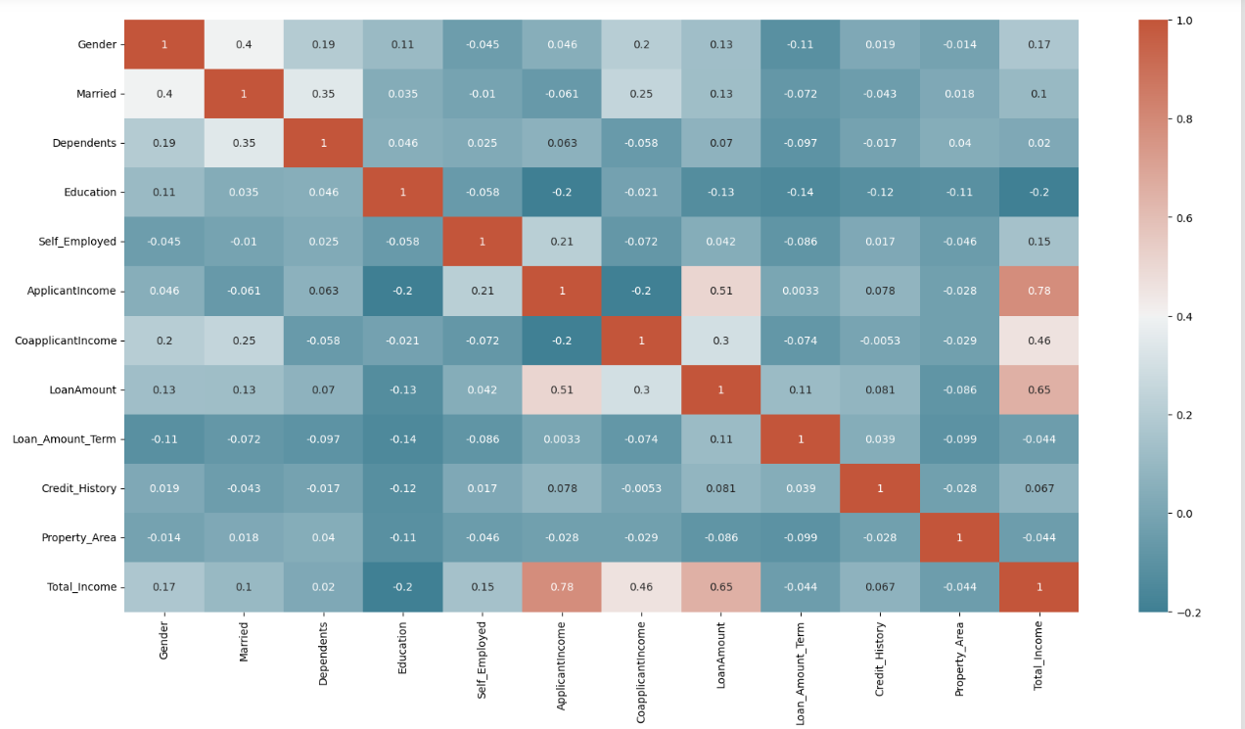
Checking for correlation
15

Slide 16
Model selection, training, and initial evaluation
Logistic Regression – 0.7341772151898734
Decision Tree – 0.879746835443038
Random Forest Classifier – 0.8860759493670886
Hyperparameter Tuning
Random Forest Classifier – 0.898746835443038
16

Slide 17
THANK YOU!
EC 9560: DATA MINING
MINI PROJECT
17

